Slide 1
Theory of Automata and Formal Language Lecture-39 Dharmendra Kumar (Associate Professor) Department of Computer Science and Engineering United College of Engineering and Research, Prayagraj March 30, 2021

Slide 2
Variations or types of TM
Non-deterministic Turing Machine(TM)
Multi-tape Turing Machine(TM)
Multi-head Turing Machine(TM)
Multi-directional Turing Machine(TM)

Slide 3
Non-deterministic Turing Machine(TM)
A non-deterministic TM is a Turing machine which, like nondeterministic finite automata, at any state it is in and for the tape symbol it is reading, can take any action selecting from a set of specified actions rather than taking one definite predetermined action.
Even in the same situation it may take different actions at different times.
It differs from deterministic TM only by transition function.
The transition function of non-deterministic TM is defined as following:-
δ: Q×Γ → 2^{Q×Γ×{L, R}}

Slide 4
Multi-tape Turing Machine(TM)
Model of TM
a | b | c | c | a | b | a | a | a | b
R/W head
a | b | c | c | a | b | a | a | a | b
R/W head
a | b | c | c | a | b | a | a | a | b
R/W head
q Finite State Control

Slide 5
Multi-tape Turing Machine(TM)
This type of machine consists of n number of tapes. Since number of tapes is n, therefore the number of heads will also be n.
Transition function will be
δ: Q×Γ^{n} → Q×Γ^{n}×{L, R}^{n}
Where
Γ^{n} = Γ× Γ× Γ×……………….. × Γ(upto n times)
{L, R}^{n} = {L, R}× {L, R}× {L, R}×……………….. × {L, R} (upto n times)

Slide 6
Multi-head Turing Machine(TM)
Model of TM
Tape
a | b | c | c | a | b | a | a | a | b
R/W head
R/W head
R/W head
q Finite State Control

Slide 7
Multi-head Turing Machine(TM)
This type of machine consists of one tape with n heads.
Transition function will be
δ: Q×Γ^{n} → Q×Γ^{n}×{L, R}^{n}
Where
Γ^{n} = Γ× Γ× Γ×……………….. × Γ(upto n times)
{L, R}^{n} = {L, R}× {L, R}× {L, R}×……………….. × {L, R} (upto n times)

Slide 8
Multi-dimensional Turing Machine(TM)
Tow-dimensional tape
Model of TM
 |  |  | U
 |  | L |  | R
 |  |  | D
Head
q Finite State Control

Slide 9
Multi-dimensional Turing Machine(TM)
This type of machine consists of one multi-dimensional tape with one heads.
The head of machine move in many directions.
If tape is n-dimensional then head move in 2^{n} directions.
Transition function of two-dimensional TM is defined as
δ: Q×Γ → Q×Γ×{L, R, U, D}
Where
L→ Left direction
R→ Right direction
U→ Up direction
D→ Down direction

Slide 10
Recursive and Recursive Enumerable language
Recursive language:
A language L is said to be recursive if there exists a Turing machine M which accepts all the strings w belong into L and rejects all the strings which do not belong into L.
Recursive Enumerable language:
A language L is said to be recursive enumerable if there exists a Turing machine M which accepts all the strings w belong into L and rejects or goes into an infinite loop for all the strings which do not belong into L.
w
M
Y
N
RE
w
M
R
Y

Slide 11
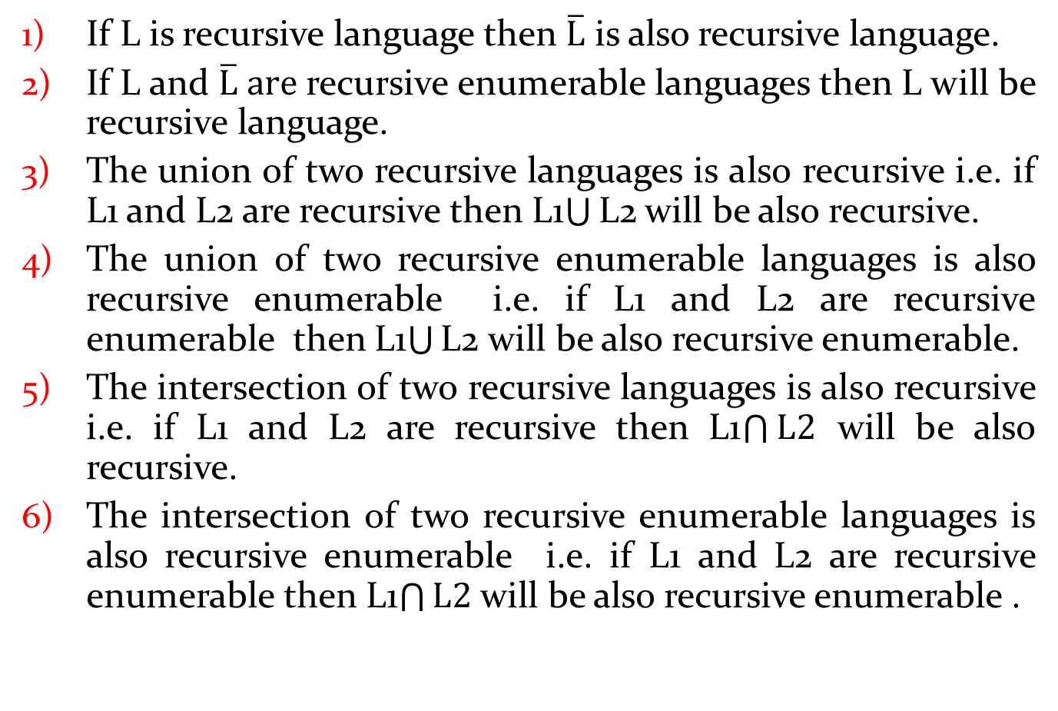
Properties of Recursive and Recursive Enumerable languages
If L is recursive language then $\overline{L}$ is also recursive language.
If L and $\overline{L} are$recursive enumerable languages then L will be recursive language.
The union of two recursive languages is also recursive i.e. if L1 and L2 are recursive then L1$\bigcup{\text{L}\text{2}}$ will be also recursive.
The union of two recursive enumerable languages is also recursive enumerable i.e. if L1 and L2 are recursive enumerable then L1$\bigcup{\text{L}\text{2}}$ will be also recursive enumerable.
The intersection of two recursive languages is also recursive i.e. if L1 and L2 are recursive then L1$\bigcap{L2}$will be also recursive.
The intersection of two recursive enumerable languages is also recursive enumerablei.e. if L1 and L2 are recursive enumerablethen L1$\bigcap{L2}$ will be also recursive enumerable .

Slide 12
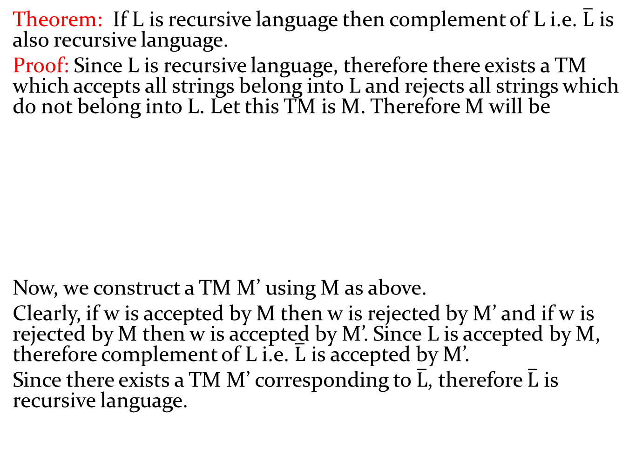
Theorem:If L is recursive language then complement of L i.e. $\overline{L}$ is also recursive language.
Proof: Since L is recursive language, therefore there exists a TM which accepts all strings belong into L and rejects all strings which do not belong into L. Let this TM is M. Therefore M will be
Now, we construct a TM M’ using M as above.
Clearly, if w is accepted by M then w is rejected by M’ and if w is rejected by M then w is accepted by M’. Since L is accepted by M, therefore complement of L i.e. $\overline{L}$ is accepted by M’.
Since there exists a TM M’ corresponding to $\overline{L}$, therefore $\overline{L}$ is recursive language.
Y
Y
M
Y
w
M
w
N
N
N
M’

Slide 13
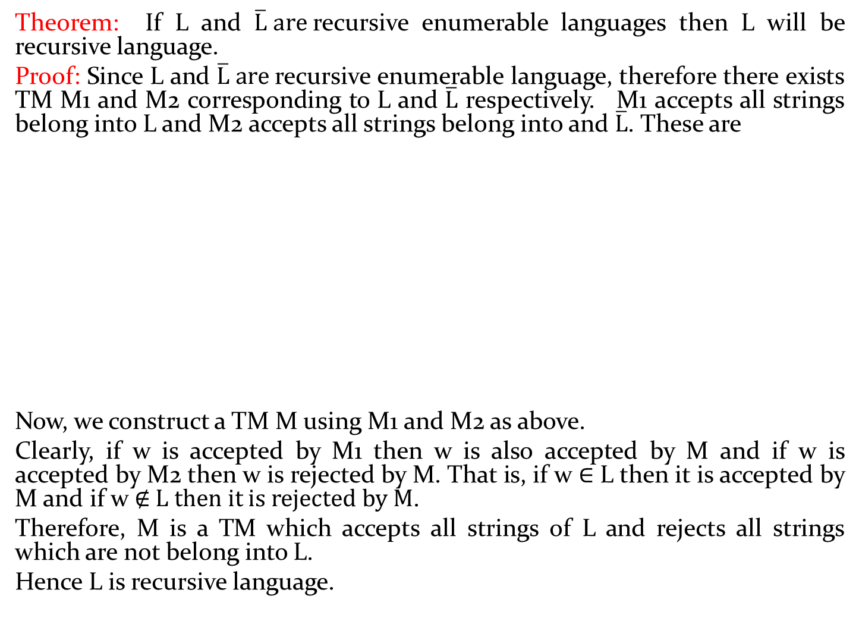
Theorem: If L and $\overline{L} are$recursive enumerable languages then L will be recursive language.
Proof: Since L and $\overline{L} are$recursive enumerable language, therefore there exists TM M1 and M2 corresponding to L and $\overline{L}$ respectively. M1 accepts all strings belong into L andM2 accepts all strings belong into and $\overline{L}$. These are
Now, we construct a TM M using M1 and M2 as above.
Clearly, if w is accepted by M1 then w is also accepted by M and if w is accepted by M2 then w is rejected by M. That is, if w ∈ L then it is accepted by M and if w ∉ L then it is rejected by M.
Therefore, M is a TM which accepts all strings of L and rejects all strings which are not belong into L.
Hence L is recursive language.
w
Y
w
Y
Y
M1
M1
w
M2
Y
Y
N
M2
M

Slide 14
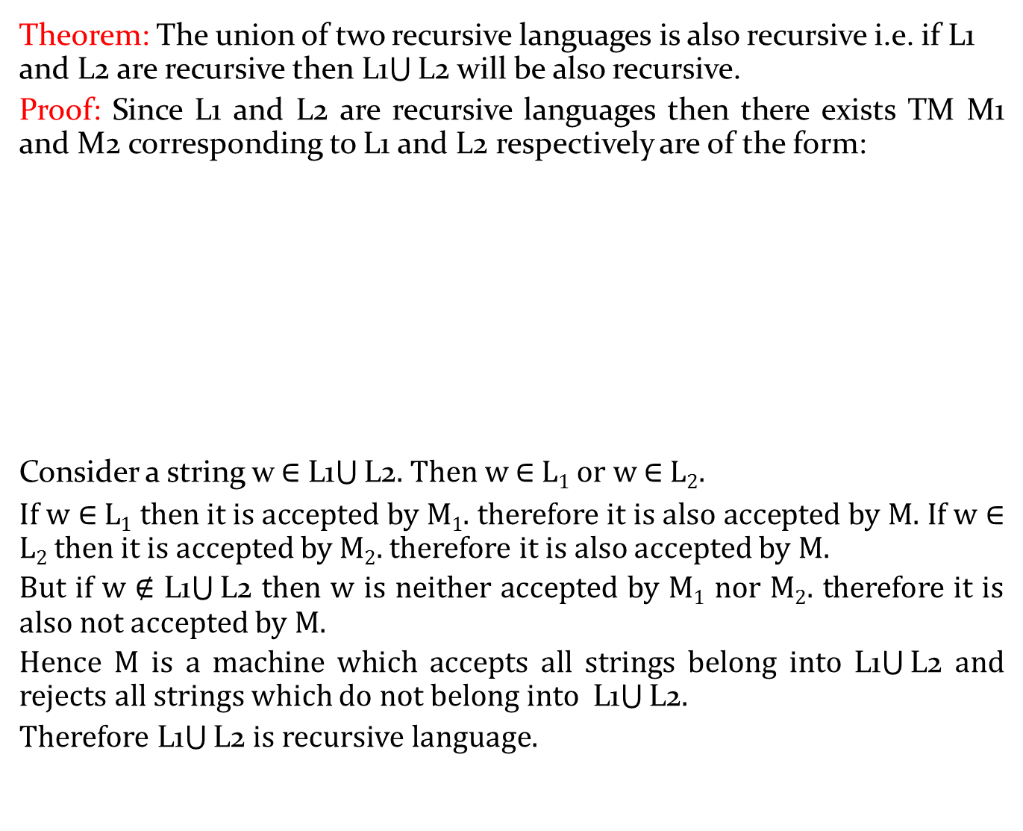
Theorem: The union of two recursive languages is also recursive i.e. if L1 and L2 are recursive then L1$\bigcup{\text{L}\text{2}}$ will be also recursive.
Proof: Since L1 and L2 are recursive languages then there exists TM M1 and M2 corresponding to L1 and L2 respectively are of the form:
Consider a string w ∈ L1$\bigcup{\text{L}\text{2}}$. Then w ∈ L₁ or w ∈ L₂.
If w ∈ L₁ then it is accepted by M₁. therefore it is also accepted by M. If w ∈ L₂then it is accepted by M₂. therefore it is also accepted by M.
But if w ∉ L1$\bigcup{\text{L}\text{2}}$ then w is neither accepted by M₁ nor M₂. therefore it is also not accepted by M.
Hence M is a machine which accepts all strings belong into L1$\bigcup{\text{L}\text{2}}$ and rejects all strings which do not belong into L1$\bigcup{\text{L}\text{2}}$.
Therefore L1$\bigcup{\text{L}\text{2}}$ is recursive language.
E-> enable
M
w
Y
M1
Y
N
w
M1
Y
N
w
Y
Y
M2
E
N
w
M2
N
N

Slide 15
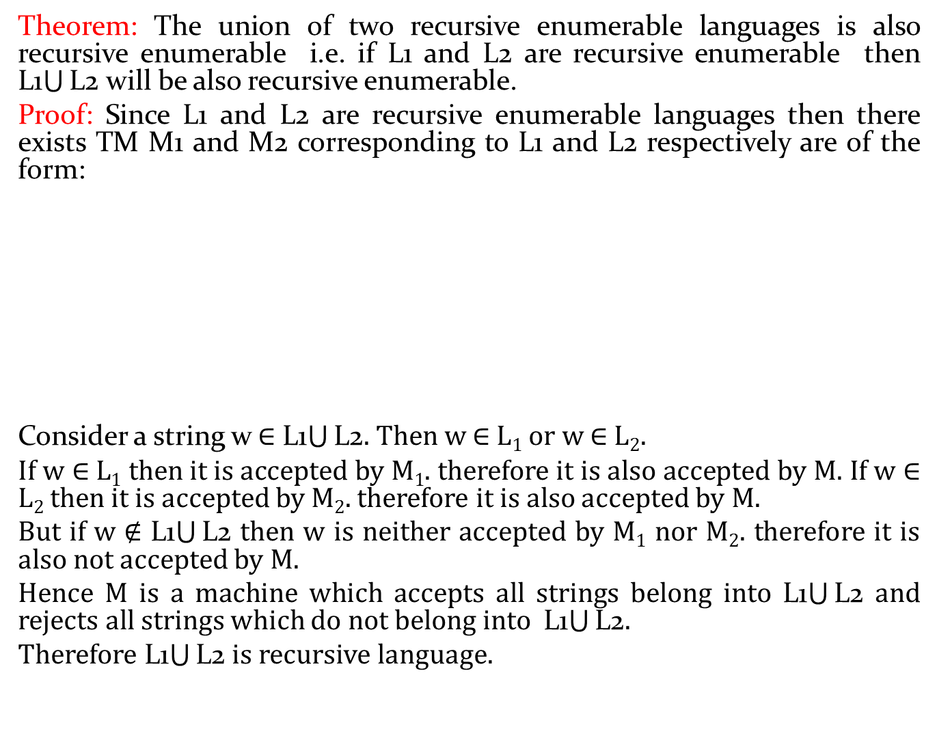
Theorem: The union of two recursive enumerable languages is also recursive enumerable i.e. if L1 and L2 are recursive enumerable then L1$\bigcup{\text{L}\text{2}}$ will be also recursive enumerable.
Proof: Since L1 and L2 are recursive enumerable languages then there exists TM M1 and M2 corresponding to L1 and L2 respectively are of the form:
Consider a string w ∈ L1$\bigcup{\text{L}\text{2}}$. Then w ∈ L₁ or w ∈ L₂.
If w ∈ L₁ then it is accepted by M₁. therefore it is also accepted by M. If w ∈ L₂ then it is accepted by M₂. therefore it is also accepted by M.
But if w ∉ L1$\bigcup{\text{L}\text{2}}$ then w is neither accepted by M₁ nor M₂. therefore it is also not accepted by M.
Hence M is a machine which accepts all strings belong into L1$\bigcup{\text{L}\text{2}}$ and rejects all strings which do not belong into L1$\bigcup{\text{L}\text{2}}$.
Therefore L1$\bigcup{\text{L}\text{2}}$ is recursive language.
M
w
M1
Y
w
Y
M1
Y
w
Y
M2
Y
M2

Slide 16
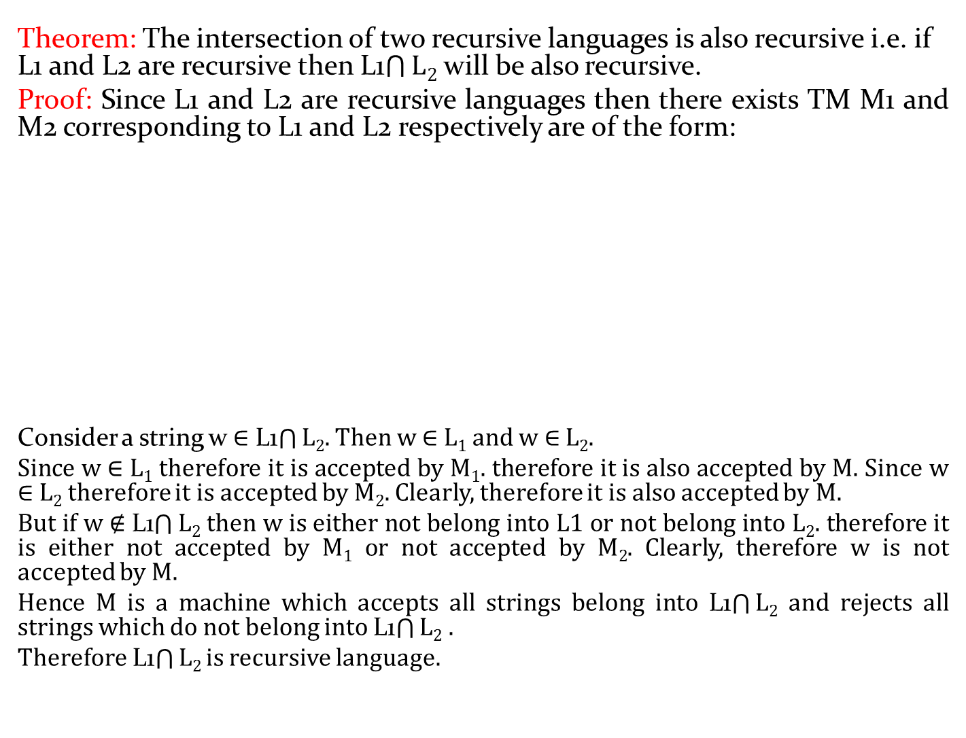
Theorem: The intersection of two recursive languages is also recursive i.e. if L1 and L2 are recursive then L1$\bigcap{L2}$ will be also recursive.
Proof: Since L1 and L2 are recursive languages then there exists TM M1 and M2 corresponding to L1 and L2 respectively are of the form:
Consider a string w∈ L1$\bigcap{L2}$. Then w ∈ L₁and w ∈ L₂.
Since w ∈ L₁therefore it is accepted by M₁. therefore it is also accepted by M. Since w ∈ L₂therefore it is accepted by M₂. Clearly, therefore it is also accepted by M.
But if w ∉ L1$\bigcap{L2}$ then w is either not belong into L1 or not belong into L₂. therefore it is either not accepted by M₁ or not accepted by M₂. Clearly, therefore w is not accepted by M.
Hence M is a machine which accepts all strings belong into L1$\bigcap{L2}$ and rejects all strings which do not belong into L1$\bigcap{L2}$.
Therefore L1$\bigcap{L2}$ is recursive language.
E-> enable
M
w
Y
M1
Y
Y
N
w
M1
N
w
Y
Y
M2
E
N
w
M2
N
N

Slide 17
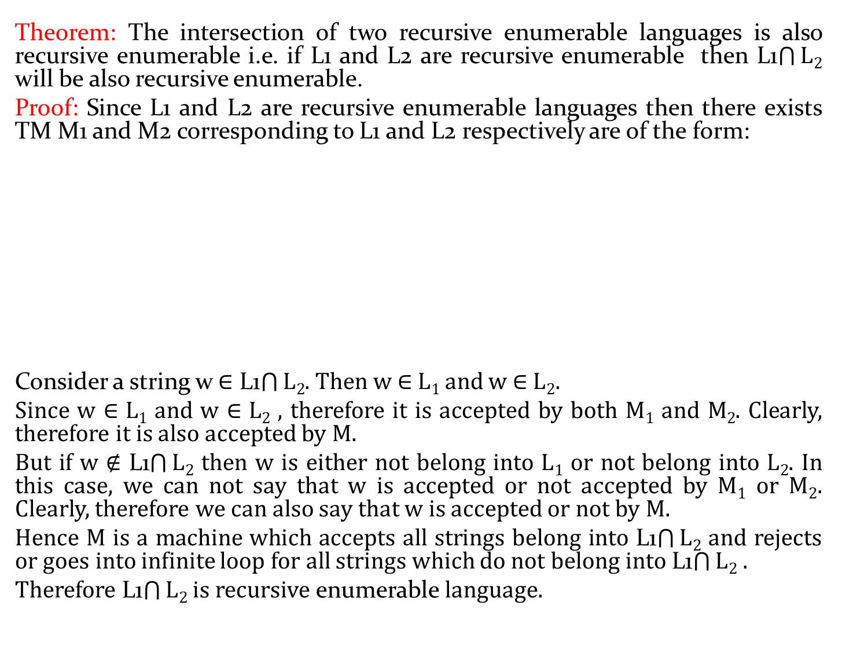
Theorem: The intersection of two recursive enumerable languages is also recursive enumerablei.e. if L1 and L2 are recursive enumerablethen L1$\bigcap{L2}$ will be also recursive enumerable.
Proof: Since L1 and L2 are recursive enumerable languages then there exists TM M1 and M2 corresponding to L1 and L2 respectively are of the form:
Consider a string w ∈ L1$\bigcap{L2}$. Then w ∈ L₁ and w ∈ L₂.
Since w ∈ L₁ and w ∈ L₂, therefore it is accepted by both M₁ and M₂. Clearly, therefore it is also accepted by M.
But if w ∉ L1$\bigcap{L2}$ then w is either not belong into L₁ or not belong into L₂. In this case, we can not say that w is accepted or not accepted by M₁ or M₂. Clearly, therefore we can also say that w is accepted or not by M.
Hence M is a machine which accepts all strings belong into L1$\bigcap{L2}$ and rejects or goes into infinite loop for all strings which do not belong into L1$\bigcap{L2}$.
Therefore L1$\bigcap{L2}$ is recursive enumerable language.
E-> enable
M
w
M1
Y
M1
Y
w
Y
w
Y
E
M2
Y
M2
w

